Slide 1

Airline Satisfaction Investigation
Team: Graff, Ruiz, Foltz, Sheahan

Slide 2
Airline Data Conceptual Map
Flight
129,000 rows of data regarding individual flights…
Origin City
Customer
Origin State
Satisfaction
Destination City
Age
Destination State
Gender
Class
Price Sensitivity
Flight Date
Year of First Flight
Spend at Airport
Loyalty
Number of Flights
Scheduled Departure
Type of Travel
Flight
Performance
Flight Time
Airline
Flight Distance
Airline Status
% Flights w/Other Airlines
Flight Cancelled
# of Other Loyalty Cards
Arrival Delay in Mins
Arrival Delay > 5 Mins
Airline Code
Departure Delay in Mins
Airline Name
Departure Delay > 5 Mins

Slide 3
Satisfaction Questions
Where does consumer satisfaction vary and why?
Is there a case for investing in satisfaction?
Are there gender differences in satisfaction?

Slide 4
Satisfaction Questions
Where does consumer satisfaction vary and why?

Slide 5
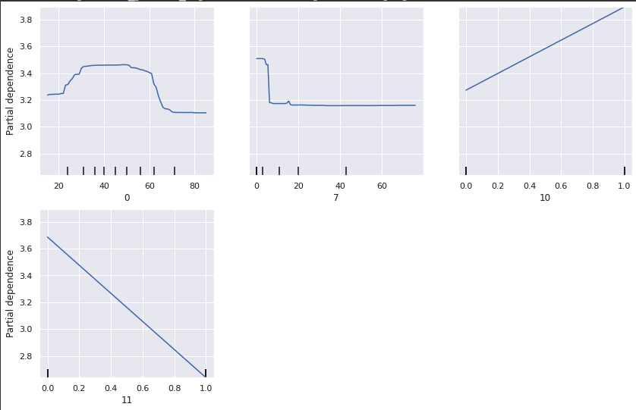
Satisfaction: Partial Dependency Plots
Age
Arrival Delay in Minutes
At left we have the four most important features from our Satisfaction model:
Age has low satisfaction in the young and old, something seen across travel type and status
Delays become meaningful just before the 10-minute mark
Personal travelers have significantly less satisfaction than business and mileage ticket peers
Silver status is associated with a satisfaction benefit
PDP Satisfaction
Type of Travel = Personal
Airline Status = Silver
PDP Satisfaction

Slide 6
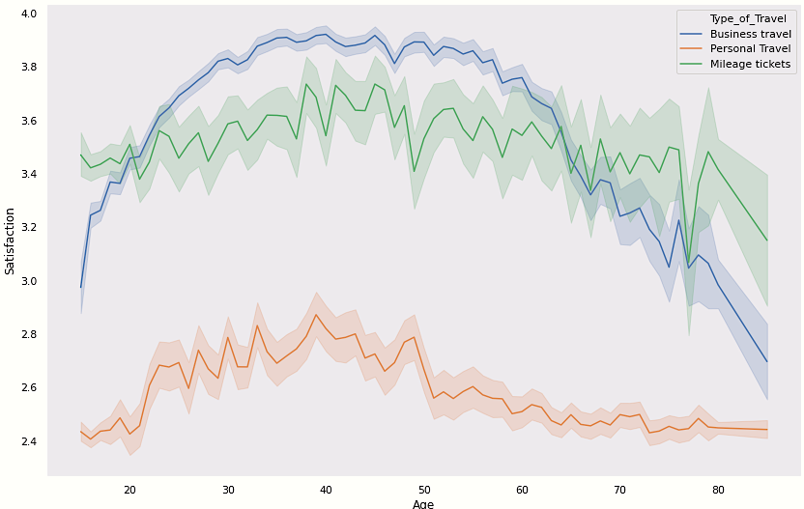
Satisfaction: Important Features
Here we can see two of the most important features for satisfaction
There are meaningful differences in satisfaction by type of travel
With business travel we see lower satisfaction in younger and older travelers – something seen to a lesser extent with personal and mileage ticket travel

Slide 7
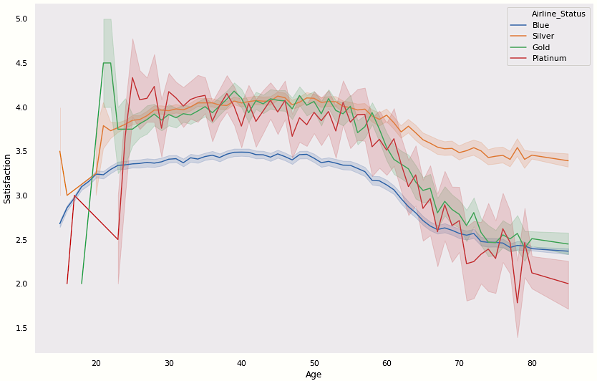
Satisfaction: Important Features
Silver has the highest satisfaction across most ages
All tiers have lower satisfaction as age increases but the higher tiers (Gold and Platinum) have comparatively lower satisfaction, breaking from the Silver tier at around age 60

Slide 8
Satisfaction Questions
Is there a case for investing in satisfaction?

Slide 9
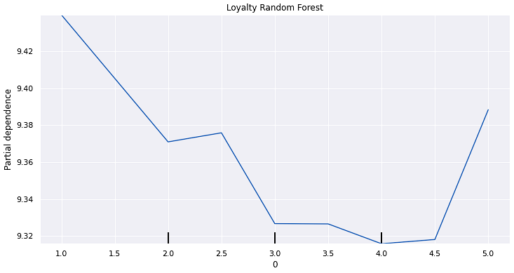
Loyalty: Important Features
We modeled the % of flights with other airlines to see if increasing satisfaction was associated with higher loyalty (lower %)
This is true up until satisfaction scores of 5.0, around 7% of the total traveling population
The movement from 1.0 to 4.5 in satisfaction could be used to help quantify investments in traveler satisfaction
PDP % of Flights w/Other Airlines
Satisfaction

Slide 10

Understanding Customers
The factors collected allow for accurate understanding of whether or not a customer will be satisfied
SVC Linear Kernel

Slide 11
Satisfaction Questions
Are there gender differences in satisfaction?

Slide 12
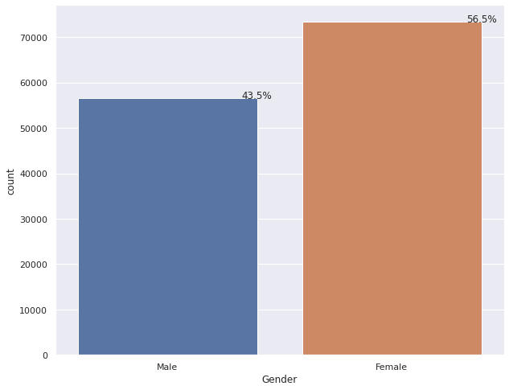
Exploratory Data Analysis
Female Passengers make up 56.5% of the dataset with +73k flights.

Slide 13
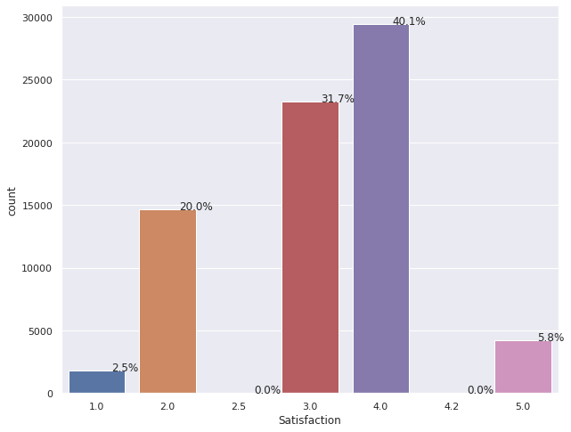
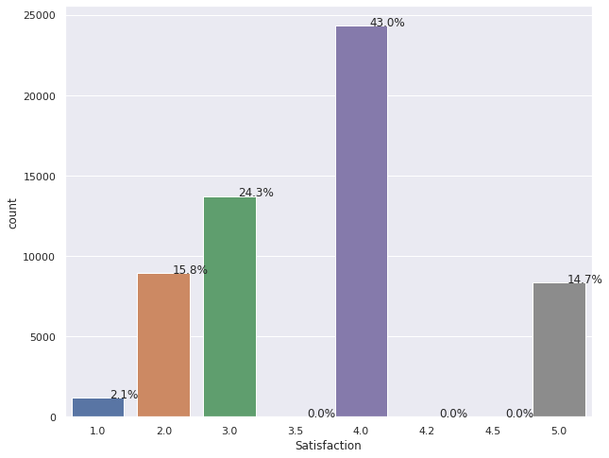
Exploratory Data Analysis (cont.)
Male passengers rated their flights as >= 4 following 58% of their flights, which is 12pts higher than the 46% for Female ratings.
Female
Male

Slide 14
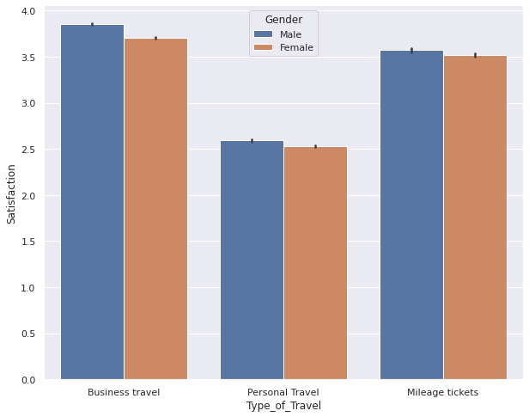
Exploratory Data Analysis (cont.)
Male passengers rated their flights higher, in aggregate, across all 3 Travel Types.

Slide 15
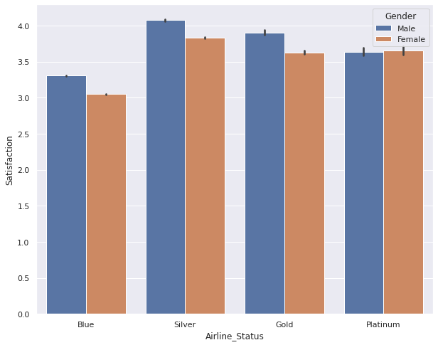
Exploratory Data Analysis (cont.)
Male passengers rated their flights higher, in aggregate, across 3 of 4 Airline Statuses. Females that flew Platinum had a better experience than the males. This is one of the few spots where Females had a higher Satisfaction score than Males.

Slide 16
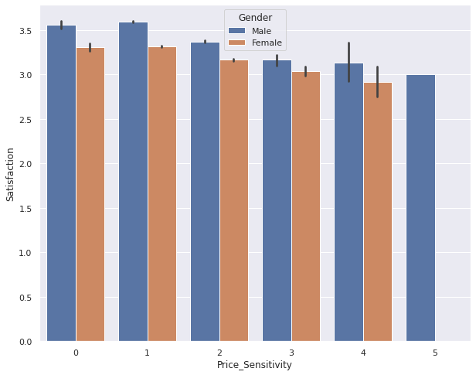
Exploratory Data Analysis (cont.)
Satisfaction scores decreased as flyers were more price sensitive.

Slide 17
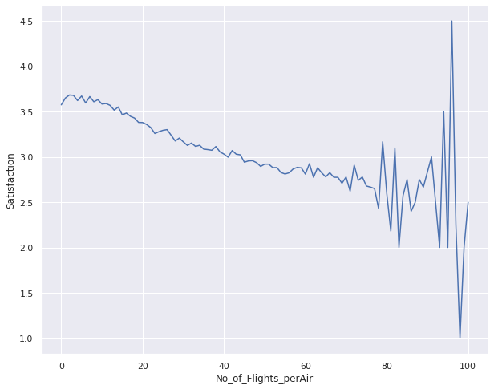
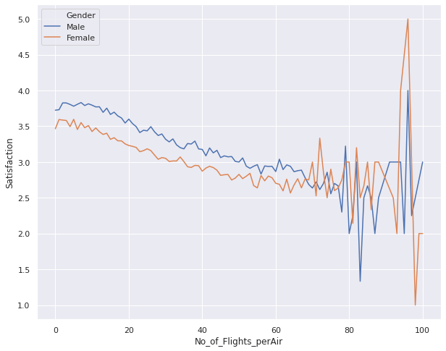
Exploratory Data Analysis (cont.)
Passenger Satisfaction decreases with the increase in # of flights. Female satisfaction has a ~1/2pt lower base of Satisfaction per flight vs Male satisfaction.
Aggregate
Male/Female Split

Slide 18
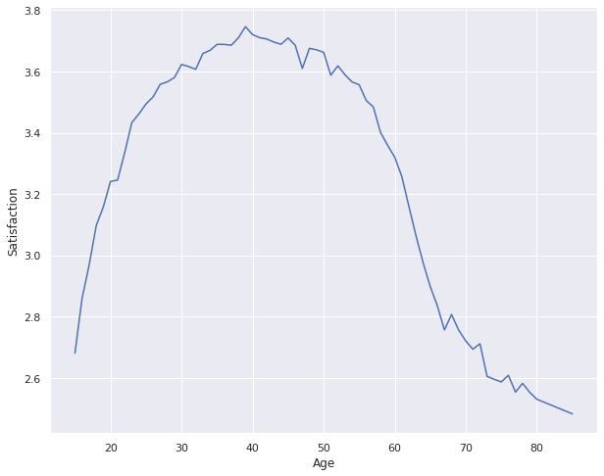
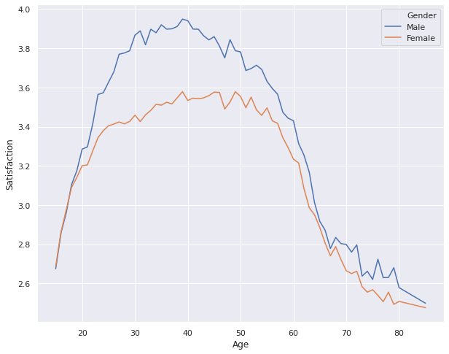
Exploratory Data Analysis (cont.)
Passenger Satisfaction and Age showed an interesting relationship. Notice how ages 30 – 55 have a score of >= 3.6, then falls off the table on either side of 30 & 55. Looking at the Male/Female split, Females have a lower aggregate score around the age of 20 and beyond.
Aggregate
Male/Female Split

Slide 19
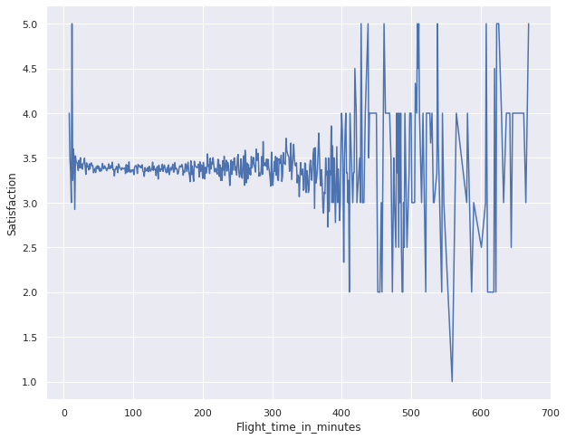
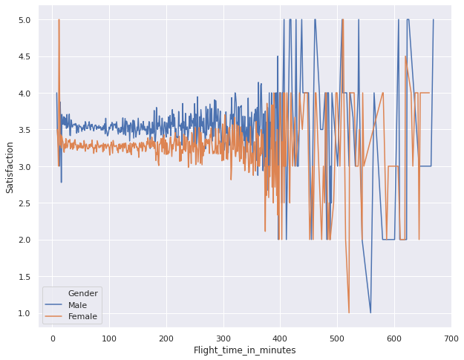
Exploratory Data Analysis (cont.)
Passenger Satisfaction and Flight Time increased in variance as flights approached the 6+ hour mark. Looking at the Male/Female split, Females have a lower aggregate score across the board.
Aggregate
Male/Female Split

Slide 20
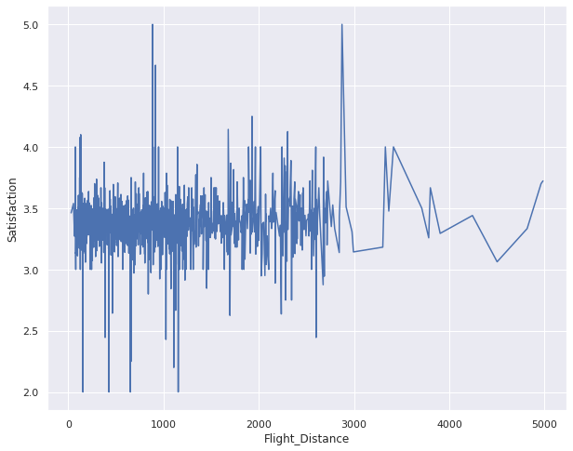
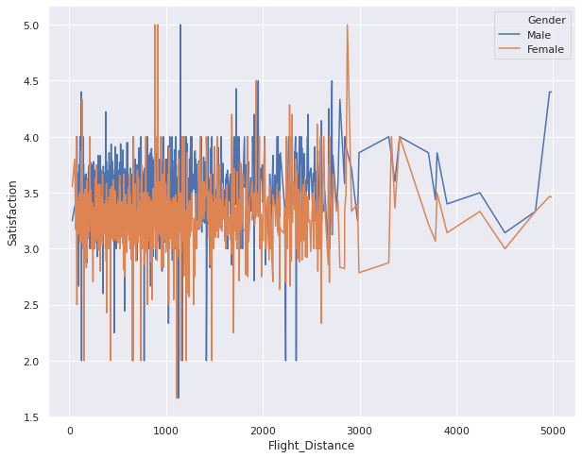
Exploratory Data Analysis (cont.)
Passenger Satisfaction and Flight Distance showed no discernable trends. Looking at the Male/Female split, Females have a slightly lower aggregate score across the board.
Aggregate
Male/Female Split

Slide 21
Appendix

Slide 22
Model Performance
Below shows each of the models that were run and their inputs, performance & time to run.

Slide 23
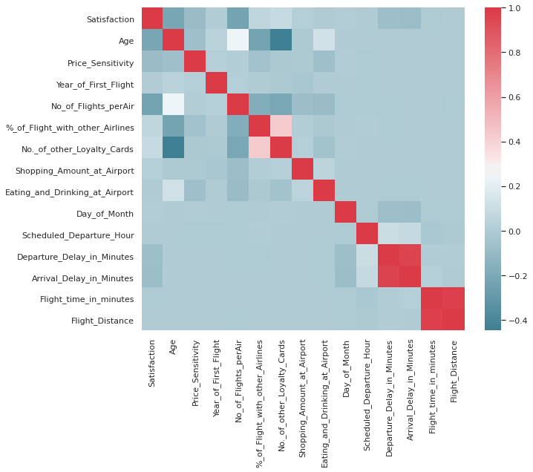
Exploratory Data Analysis (cont.)
Correlation Matrix does not provide any strong correlation (r > +-0.5) outside of two sets of highly dependent variables (departure delay/arrival delay & flight time/flight distance).

Slide 24
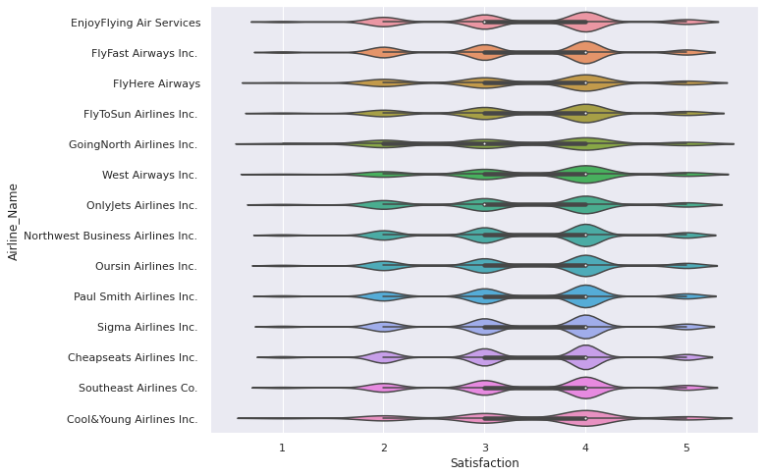
Exploratory Data Analysis (cont.)
Violinplot that shows the density of each Satisfaction rating for the 14 airlines in the dataset.

Slide 25
Sources
Github:
https://github.com/itsAmeMario0o/BDA718-PROJECT
Images:
https://www.freepik.com/free-vector/airplane-realistic-poster_3796059.htm#page=1&query=airline&position=0
PPT Template:
https://www.slidescarnival.com/category/free-templates

